Slide 1


Presented by The Espada
{Sean J, Mecca A, Arsh A, Cindy Z, Karthik B, Debasree S}

Slide 2
Agenda
Introduction
2NF model diagram
Landing Demo
Use cases + User Journey Demo
User Action Demo
Reporting Demo
Stored Procedures
Job Delegation
Extra Credit

Slide 3



Our Business Idea: GoldLinks
What is GoldLinks?
It is a web-based platform that helps users compare local gold prices and store info in real-time.
2 Types of Users
Customer: Browse and compare gold products from nearby stores
Business Owner: Manage store details, add latest products and prices.
Use?
To get accurate and real-time updates, compare store and products, and also easy to navigate.

Slide 4





Frontend
Backend

Slide 5
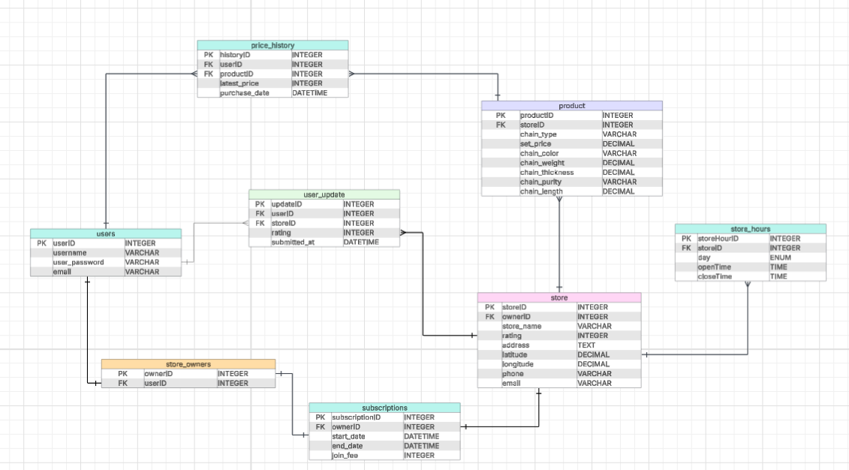
2NF Relational Model

Slide 6
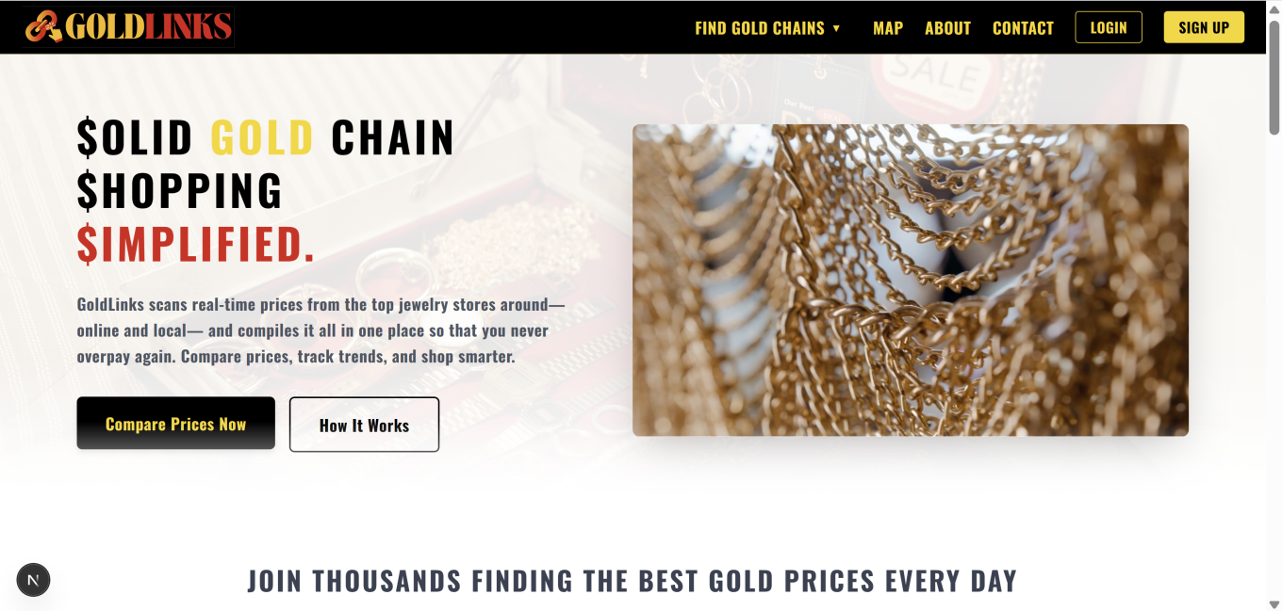
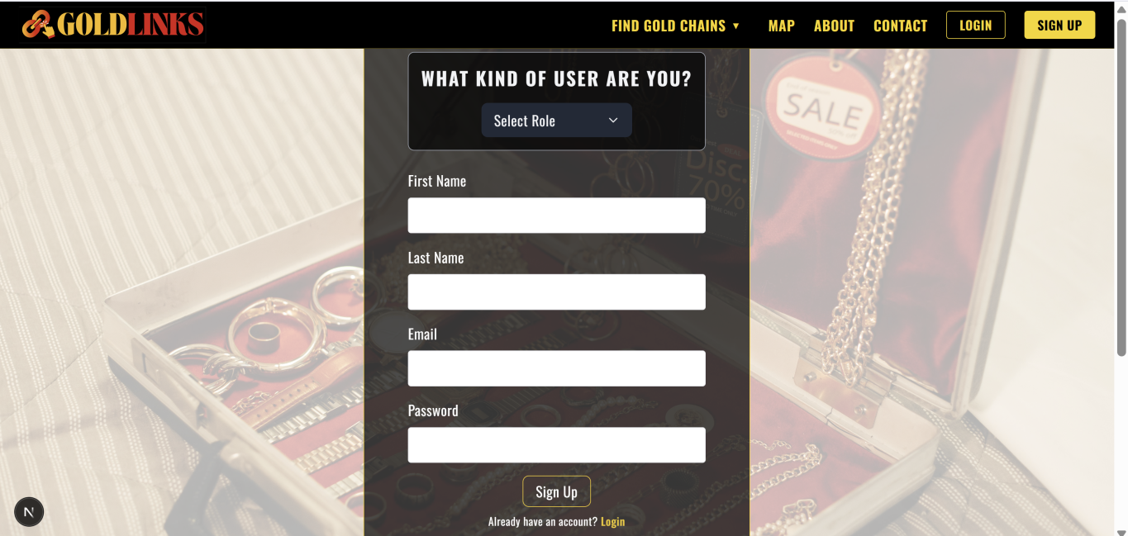
Landing Demo
Landing Page
Signup Component

Slide 7



Use Cases
Store and Product Comparison
Latest Gold Price Updates
Navigation Ease
Community Driven

Slide 8
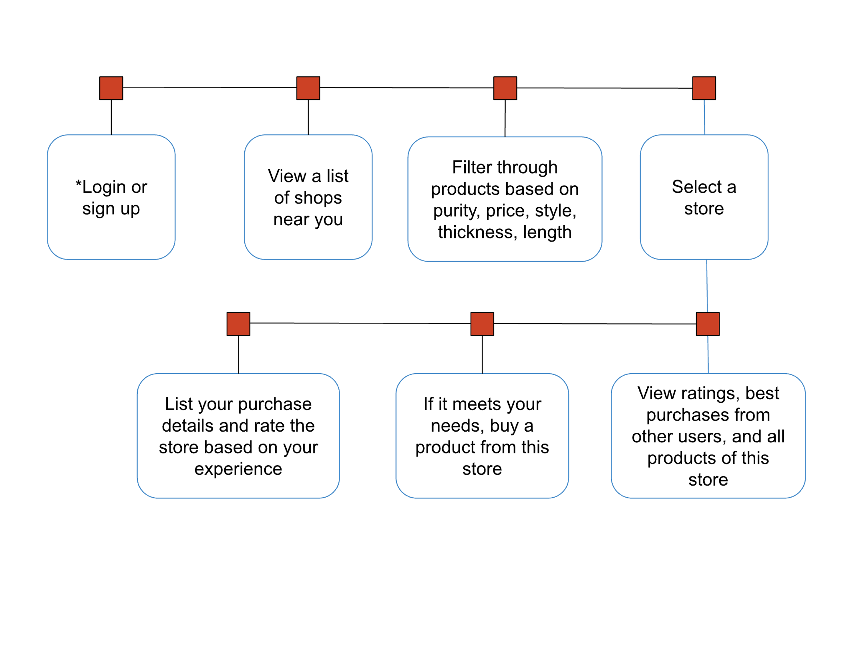
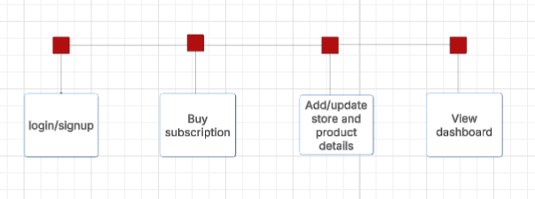
User Journey
Regular User
Business (Store Owner) User

Slide 9
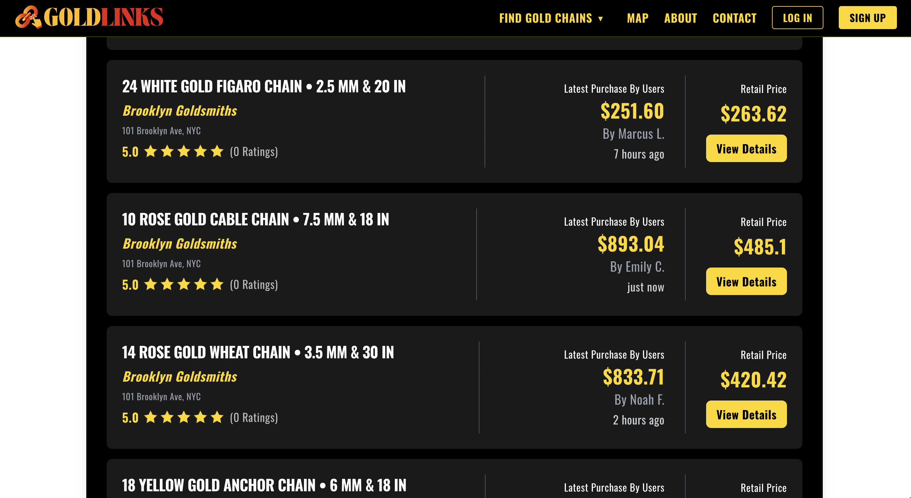
User Action & Revenue + Demo
Demo for showing user experience and functionality

Slide 10
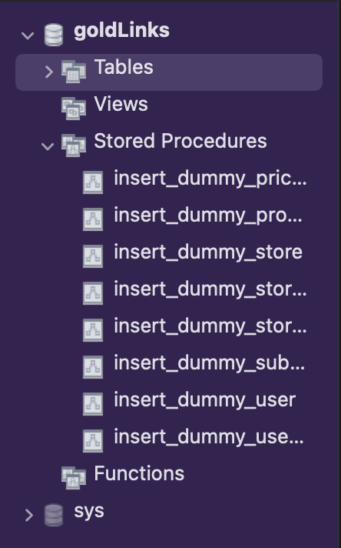
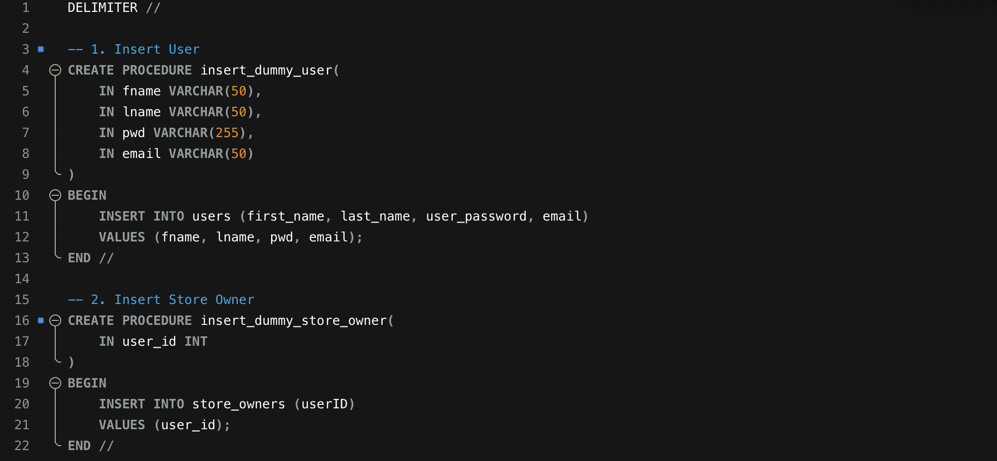
Stored Procedures Demo
Demo for showing stored procedures for inserting dummy data

Slide 11
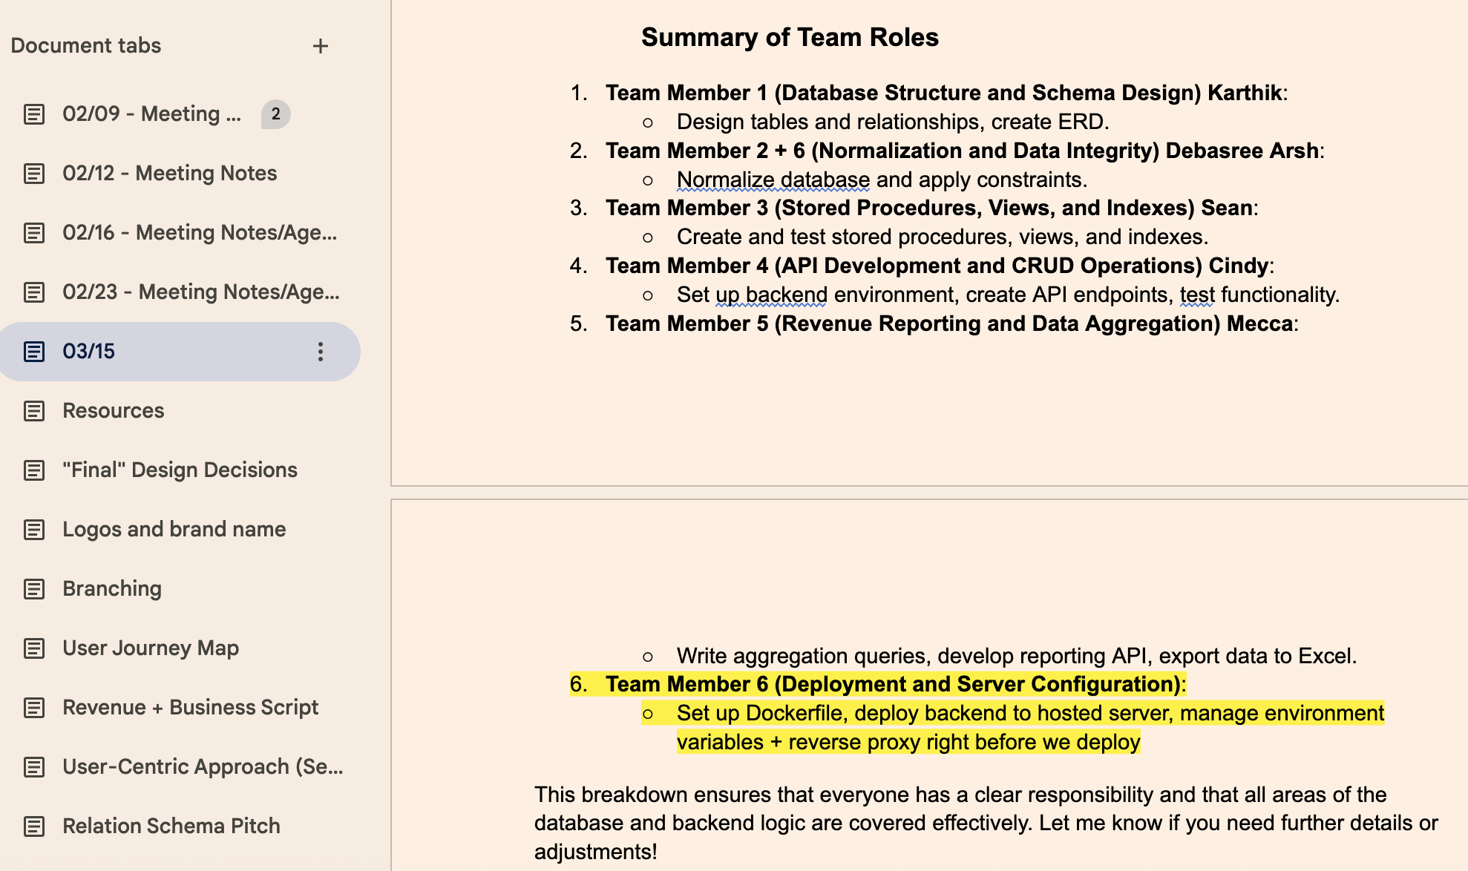
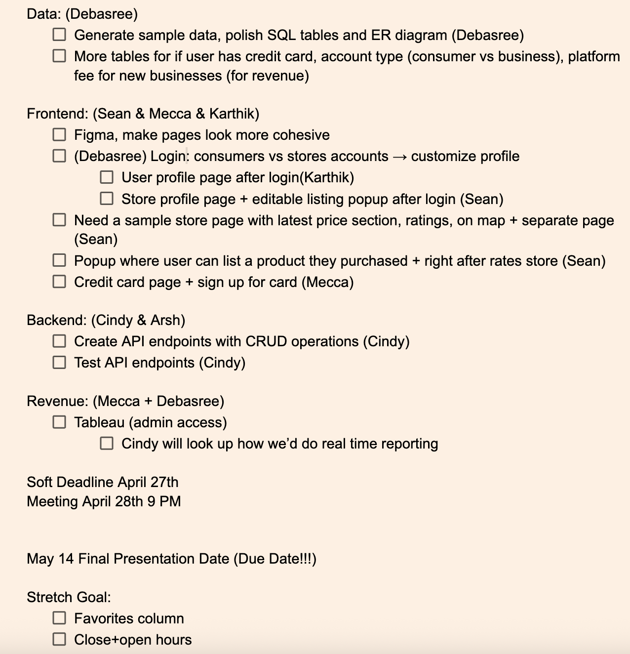
Job Delegation
Role Delegation:

Slide 12
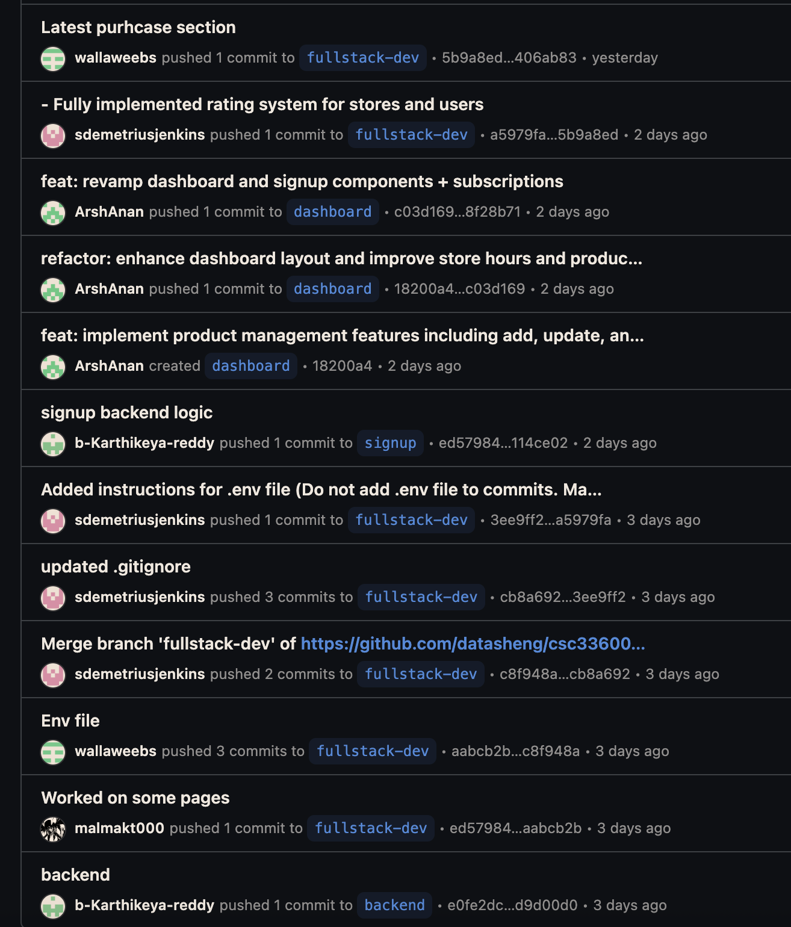
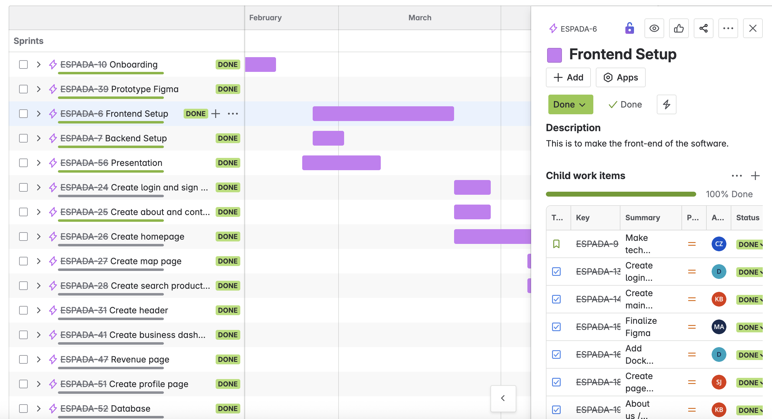
Job Delegation
Worked on Different Branches for Features and Frontend/Backend
Updated Jira with delegated task roles, deadlines, and completions

Slide 13
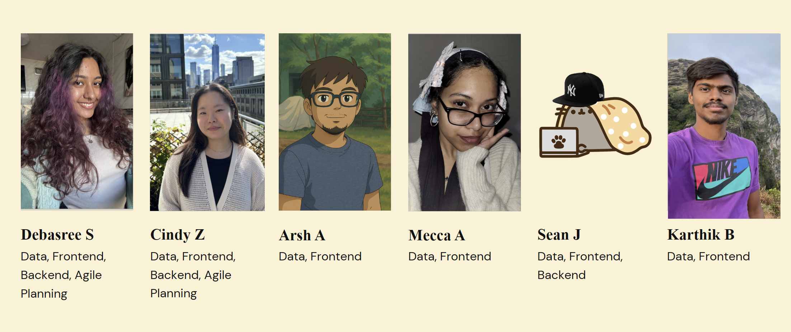
Teamwork
Role Delegation:

Slide 14
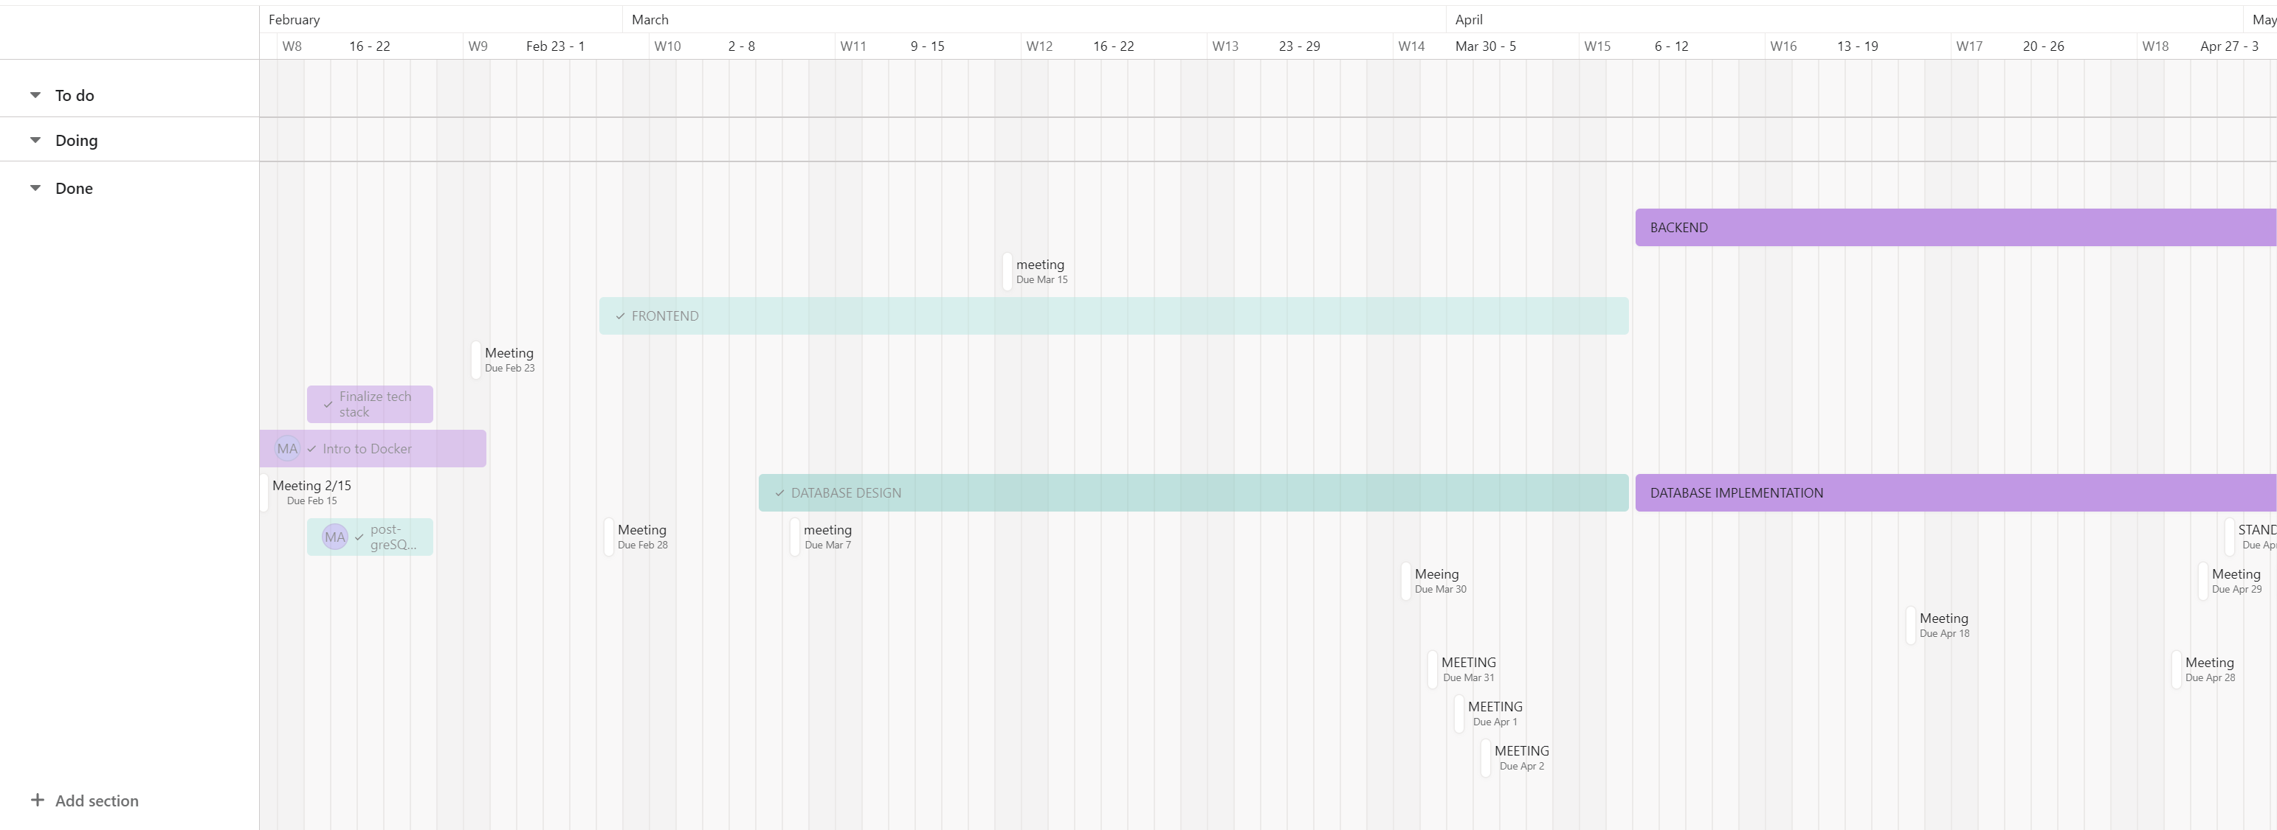
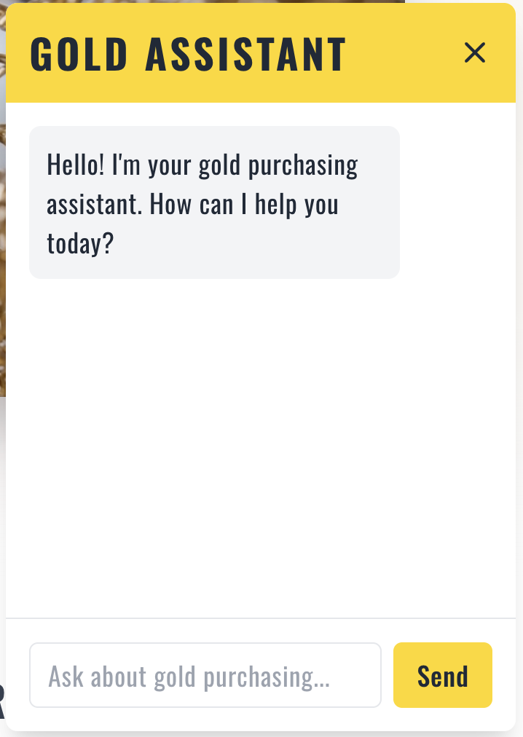
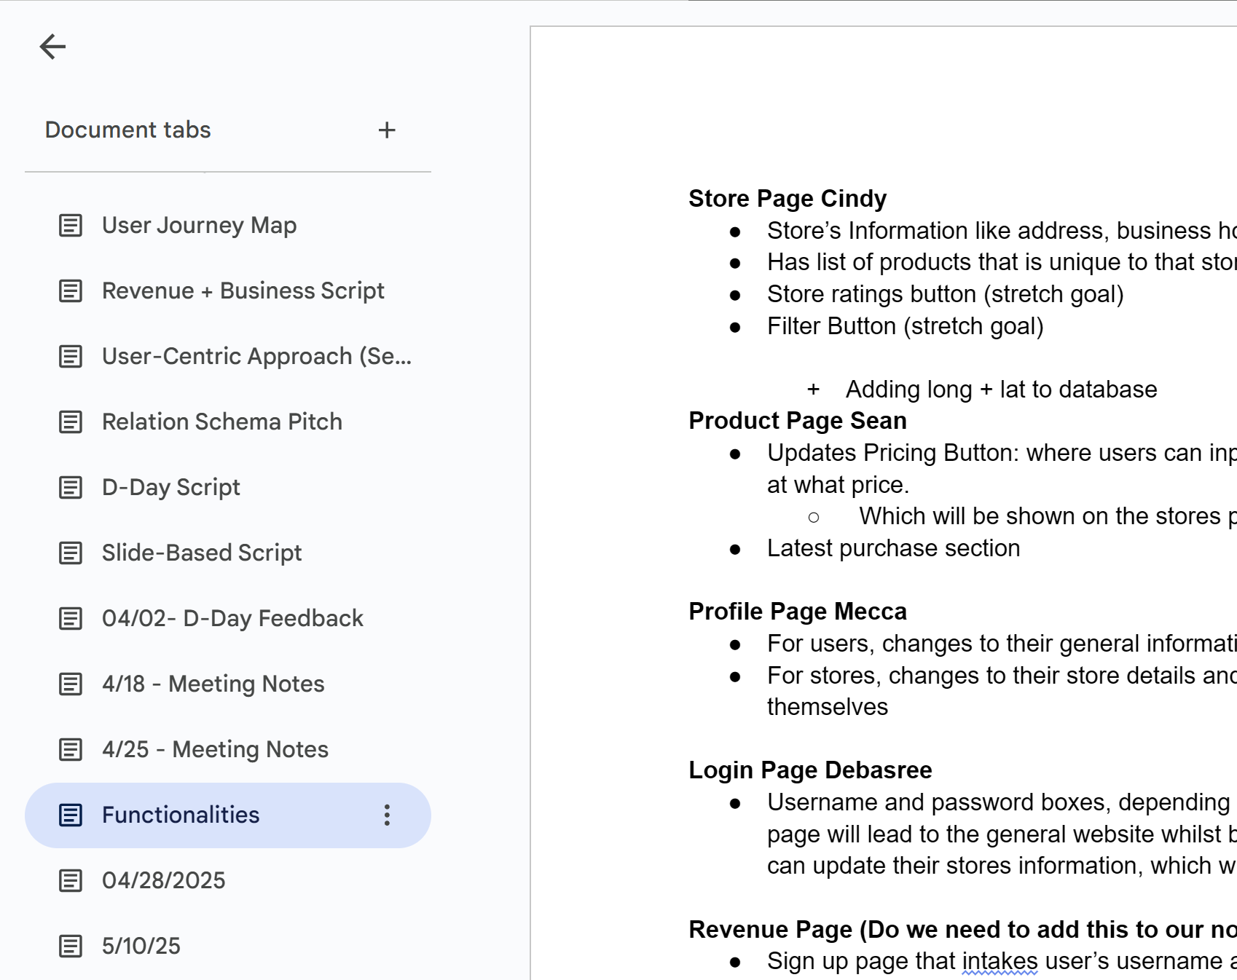
Extra Credit
A user-friendly web UI with a UX-focused approach. ✅
Using an Agile methodology with tools like Jira or Asana for project tracking is beneficial but not required. ✅
Adding AI capabilities within the application is an optional but valuable feature. ✅
Incorporating API, WebSocket, OAuth, or Cloud Technology is recommended for a more robust application. ✅

Slide 15

Questions?

